Slide 1


*BLACK
GIRLS
CODE_
Quantum Art!

Slide 2
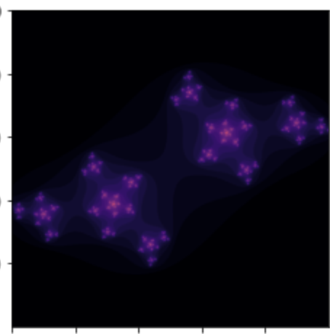
Group Name

